Slide 1
The Annual Conference on Software Analysis, Testing and Evolution (SATE)
Software Bug Localization Based on
Key Range Invariants
Lin Ma, Zuohua Ding
School of Information Science Zhejiang Sci-Tech University
linma123@163.com
2018-11-23

Slide 2
Motivation
Our Method
Experiments
Conclusion
Content :

Slide 3
MOTIVATION
With the continuous expansion of software systems, automatic software bug localization technology has received extensive attention. At present, many automatic software bug localization methods have been proposed to assist testers and developers to locate bugs in software more quickly.

Slide 4
MOTIVATION
Software bug localization based on range invariants
Method flow :
Assumption:
The error program, inputs, and expected outputs are known.

Slide 5
MOTIVATION
Range Invariant Training :
New Result Value | Range
 | ∅
5 | [5,5]
20 | [5,20]
2 | [2,20]
10 | [2,20]
... | ...
Note :
There are no observations at first, so the initial range is empty.

Slide 6
MOTIVATION
Advantage | It is easy to locate bug related to variables and has higher positioning accuracy.
Disadvantages | It needs to monitor all variables in all statements of the system.
Problem :
In large software systems, the overhead required to monitor all variables in the system is a hindrance.
Is it possible to monitor some key variables to locate bug ?

Slide 7
OUR METHOD
Software bug localization based on key range invariants .
Method flow :
The difference :
Adds a key variables screening phase
Only key variables are trained and monitored

Slide 8
OUR METHOD
Software bug localization based on key range invariants .
Step 1. The key variables screening
Step 2. The key range invariants training
Step 3. Bug localization

Slide 9
OUR METHOD
Step 1. The key variables screening :
In this phase, use a combination of dynamic and static filtering methods to filter variables in the program. Dynamic filtering mechanism is divided into dynamic filtering mechanism I and dynamic filtering mechanism II. Finally, we can get a key variables set KEY.

Slide 10
OUR METHOD
Dynamic Filtering Mechanism I :
The purpose : filter a class of non-key variables.
Feature : This class of variables values is always increases or decreases in the same way during each execution of the program, regardless of the input.

Slide 11
OUR METHOD
Dynamic Filtering Mechanism I :
We use the delta (Δ) to implement an increase or decrease of the variable value.
Δ = the current observation value - the last observation value

Slide 12
OUR METHOD
Dynamic Filtering Mechanism II :
The purpose : filter a class of non-key variables
from KEY set.
Feature : The range of this class of variables values is always the same after each complete execution of the program, regardless of the input.

Slide 13
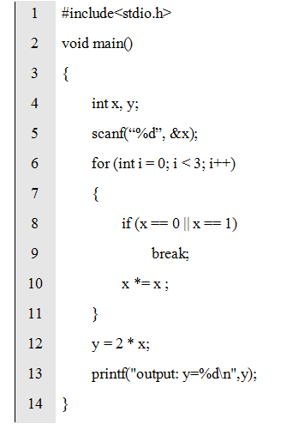
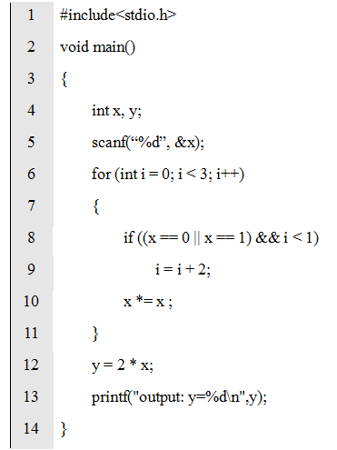
OUR METHOD
Dynamic Filtering Mechanism
Examples :
< I >
< II >
Regardless of the input,
In <I>, the value of the variable ' i ' is always incremented in the same way, Δ is 1.
In <II>, the value of the variable ' i ' is always in the range [0, 3] after a complete execution.

Slide 14
OUR METHOD
Static Reduction Mechanism :
The purpose : filter a class of non-key variables
from KEY set.
Feature : This class of variable has the same value during the function is called, regardless of the input.

Slide 15
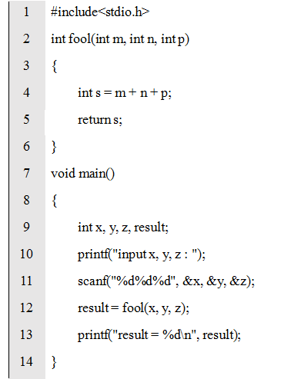
OUR METHOD
Static Reduction Mechanism
Examples :
Regardless of the input,
during the call of the function fool(), the values of the variables ' m, n, p ' in the function remain the same.

Slide 16
OUR METHOD
Step 2. The key range invariants training :
Process :

Slide 17
OUR METHOD
Note :

Slide 18
OUR METHOD
Continuous Range Invariant Training : Discrete Range Invariant Training :
New Result Value | Range
 | ∅
5 | [5,5]
20 | [5,20]
2 | [2,20]
10 | [2,20]
... | ...
New Result Value | Range
 | ∅
5 | {5}
20 | {5,20}
2 | {2,5,20}
10 | {2,5,10,20}
... | ...
Note :
There are no observations at first, so the initial range is empty.

Slide 19
OUR METHOD
Step 3. Bug localization :
Process :

Slide 20
EXPERIMENTS
Experimental set :
Siemens Set
Program | Faulty_Versions | LOC | Test_Cases | Description
print_tokens | 7 | 564 | 4130 | Lexical analyzer
print_tokens2 | 10 | 511 | 4115 | Lexical analyzer
replace | 32 | 564 | 5542 | Pattern matching and substitution
schedule | 9 | 413 | 2650 | Priority scheduler
schedule2 | 10 | 308 | 2710 | Priority scheduler
tcas | 41 | 174 | 1608 | Aircraft collision avoidance system
tot_info | 23 | 407 | 1052 | Computes statistics given input data

Slide 21
EXPERIMENTS
The effectiveness of our method is verified by comparing the following three aspects:
<1> The number of variables to be monitored
<2> The number of suspicious statements to be checked
<3> The number of error versions located

Slide 22
EXPERIMENTS
<1> The number of variables to be monitored :
In the figure,
the horizontal axis is the test set.
the vertical axis is the average number of variables to be monitored.

Slide 23
EXPERIMENTS
<2> The number of suspicious statements to be checked :
In the figure,
the horizontal axis is the different error version of the test set.
the vertical axis is the number of suspicious statements to be checked.

Slide 24
EXPERIMENTS
<3> The number of error versions located :
Program | print_tokens | print_tokens2 | replace | schedule | schedule2 | tcas | tot_info
V_T | 2 | 4 | 16 | 4 | 2 | 15 | 17
V_O | 2 | 2 | 16 | 4 | 1 | 15 | 14
In the table,
V_T indicates that the number of erroe versions located by the range invariants bug localization method.
V_O indicates that the number of error versions located by the key range invariants bug localization method.

Slide 25
CONCLUSION
By using our method to locate bugs,
the reduction in the number of variables to be monitored is quite significant.
the number of suspicious statements to be checked has also reduced.
the good bug location effect is still maintained.

Slide 26
THANK YOU !

